Slide 1
Intercultural Interactions Session 10
Course : CB Pancasila
Effective Period : 2017

Slide 2
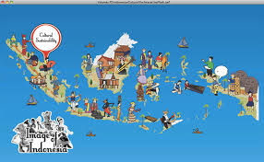
Student will be able to explain the cultures interaction in human life
Learning Objectives
behance.net

Slide 3
Culture
Culture is derived from the Sanskrit, buddhayah which is the plural of the word buddhi, which means “mind" or “reason”.
Culture associated with the forces of reason that manifests itself in creativity, taste and intention
The word culture (English) collere (Latin) means cultivating the soil or farming, relations with nature.
Culture relates to the value that is considered valuable by a group as a reference of life

Slide 4
According to Tylor: culture is the overall complexity which includes knowledge, belief, art , morals, law, customs and any other capabilities and habits of humans as members of society
According to Geertz: culture is a pattern of meanings embodied in symbols inherited , communicated , preserved and developed historically through a system of knowledge and attitude to life

Slide 5
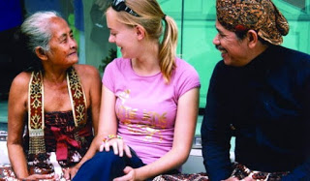
Intercultural Interactions
Intercultural interaction can be implemented through communication
b. Intercultural communication occurs between people who have different cultures (in race, ethnicity, socioeconomic, or a combination of all these differences )
c. One cultural group meetings with other cultural groups create interaction and mutual influence each other that brings positive and negative influences.
http://www.irmanfsp.com/2015/08/pengertian-komunikasi-antar-budaya.html

Slide 6
Challenges of Intercultural Interactions
Intercultural interactions can bring out conflicts between / among cultures
Psycho-personal challenge: anxiety, shock, antipathy, racist, ethnocentric, suspicion, intolerance, negative thinking, exclusive, etc.
Serious challenges of cross-cultural interaction in the context of Indonesia is cultural disorientation

Slide 7
Unity in Diversity
Every culture owner should perceive a positive culture of other cultures different actors.
Interaction between cultures needs to be done in the spirit of promoting mutual develop, supporting each other, learning from each other to enrich each other
Intercultural cooperation and cultural education should be encouraged in various fields towards a better life in Indonesia

Slide 8
Discussion
What is your idea to face globalization

Slide 9
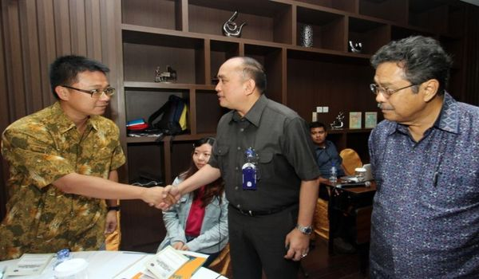
Case Study
Read the article based on the following link ….
And give your opinion
http://www.beritasatu.com/nasional/183636-ekspatriat-wajib-patuhi-norma-dan-budaya-kerja-di-indonesia.html

Slide 10
Question and Answer
?

Slide 11
References
Tim Penulis CB: Pancasila (2014). Diktat Kuliah Character Building: Pancasila. Binus University: CBDC, 00
Wawasan nusantara: http://pancasilazone.blogspot.com/2012/04/wawasan-nusantara.html
Gambar pada Learning Objective: behance.net
Gambar orang berinteraksi : http://www.irmanfsp.com/2015/08/pengertian-komunikasi-antar-budaya.html
Case study & gambar: http://www.beritasatu.com/nasional/183636-ekspatriat-wajib-patuhi-norma-dan-budaya-kerja-di-indonesia.html

